Slide 1
Instruction Set Architecture
Roshan Koju
NCIT
2017

Slide 2
Introduction
The instruction set architecture (ISA), , also called instruction set is part of a computer that pertains to programming, which is basically machine language. The instruction set provides commands to the processor, to tell it what it needs to do. The instruction set consists of addressing modes, instructions, native data types, registers, memory architecture, interrupt, and exception handling, and external I/O.

Slide 3
Programmers visible part
Registers (where data resides)
Addressing modes (how those data are accessed)
Instruction format (how are instruction specified)
Control statements (exceptional conditions)
Instruction set (what operations can be performed)

Slide 4
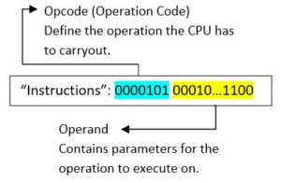
Instruction sets have their rules like a language has grammar. An instruction includes an opcode that specifies the operation to perform, such as add/multiply/move contents of memory to register—and operand specifiers, which may specify registers, memory locations, or literal data.
According to the opcode, the CPU actually
  triggers the necessary circuit associated with
  it to get the required output. These instructions
  are stored in the ROM of the system and are called
  upon as the program executes.

Slide 5
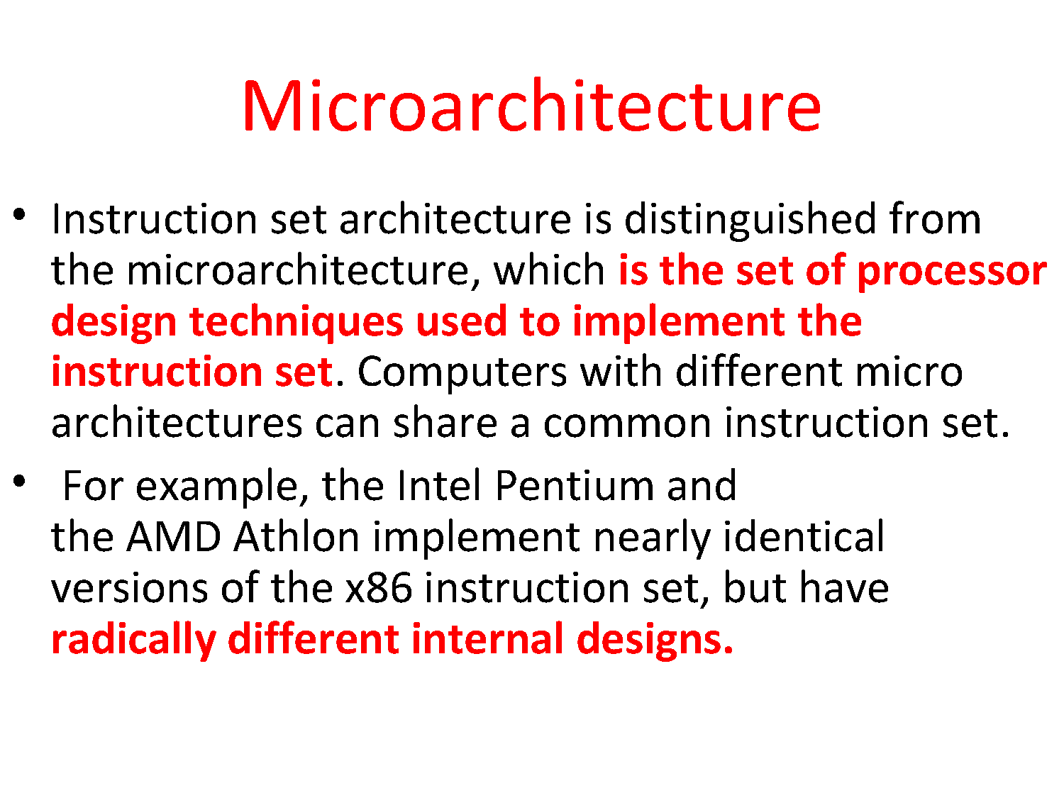

Slide 6
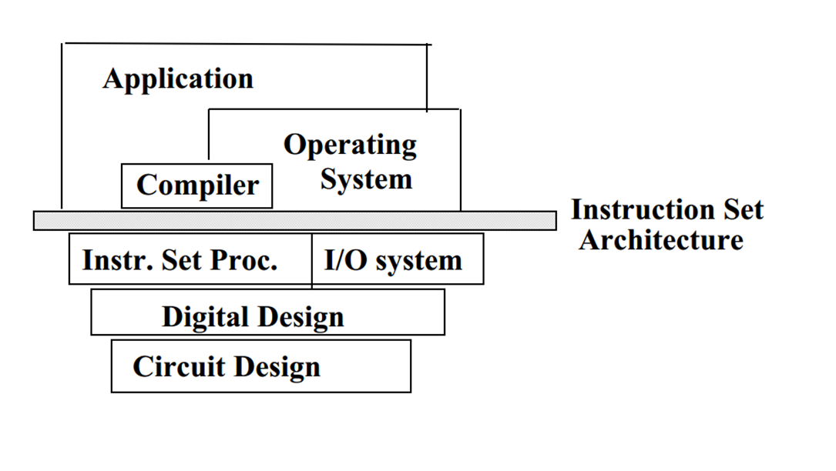
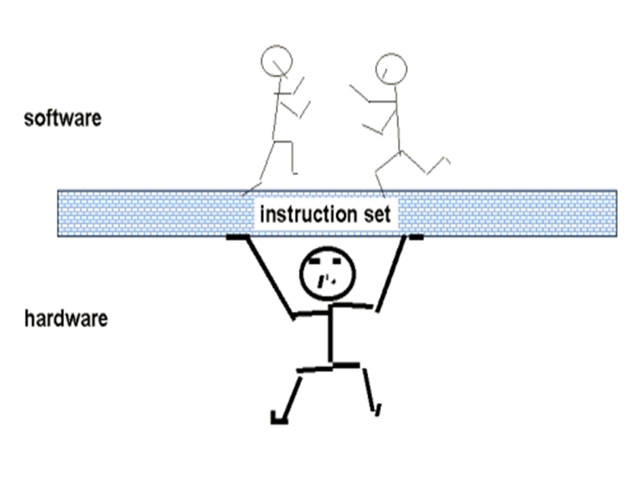
The ISA serves as the boundary between software and hardware.

Slide 7
Design issues of ISA
Number of operations
  Number of instruction
Size of instructions
  Fixed or variable
Data Access technique
  Memory or register
Location of operands
  Memory or register

Slide 8
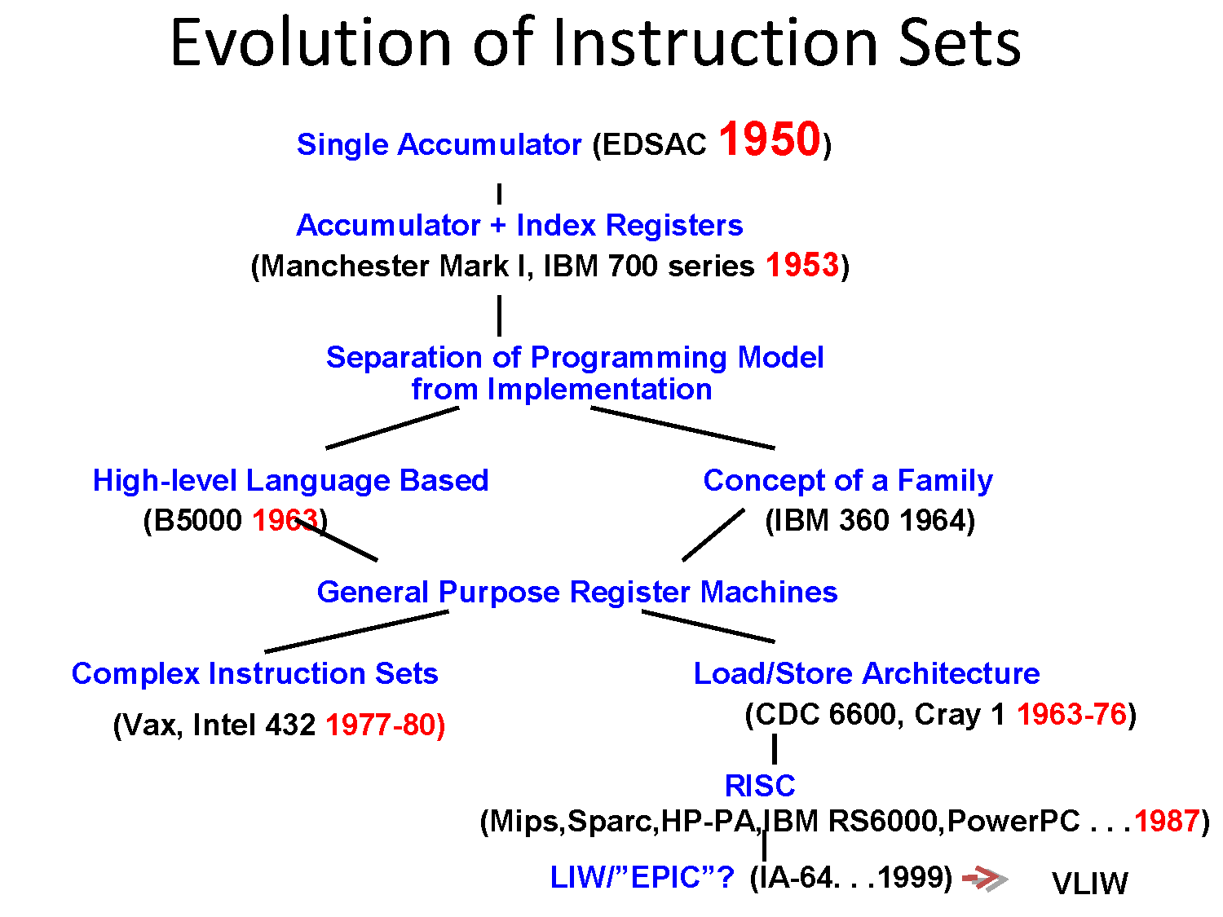

Slide 9
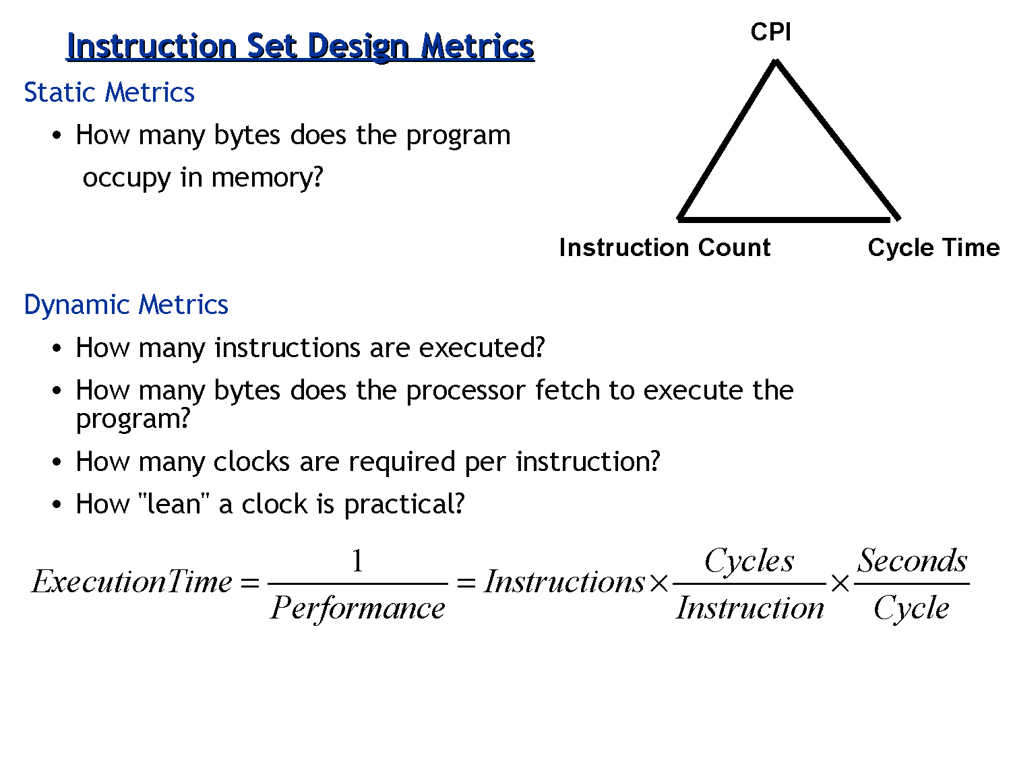

Slide 10
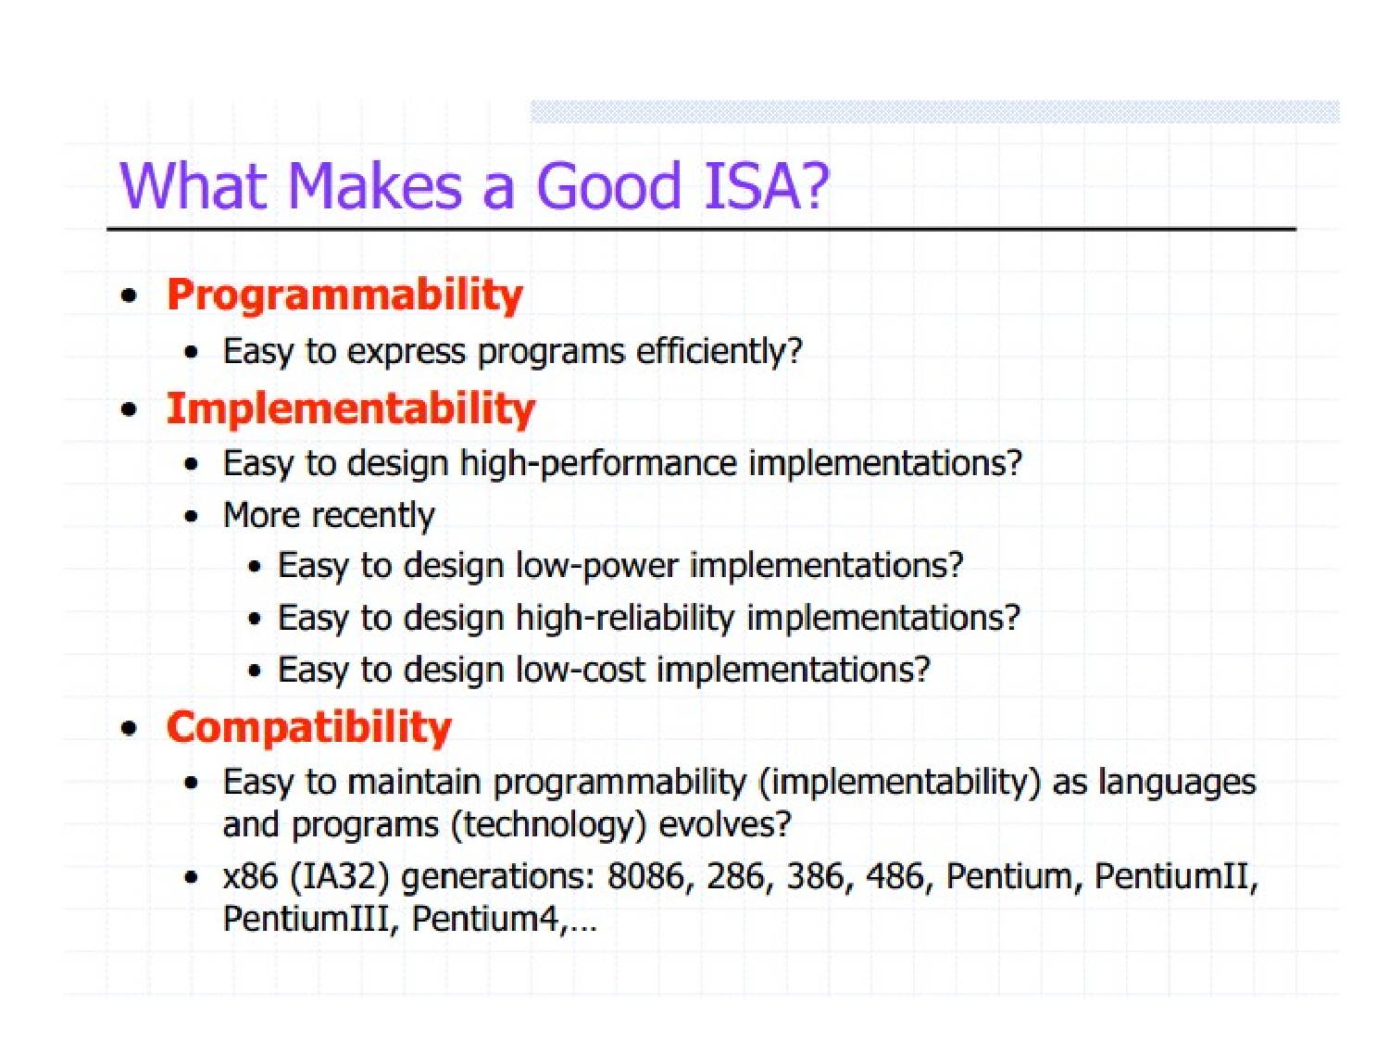

Slide 11
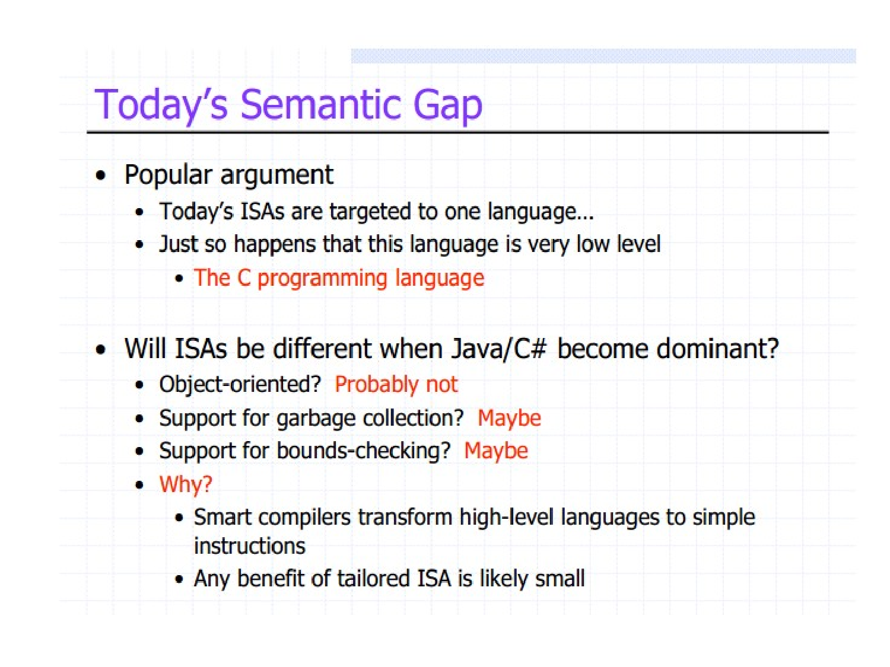

Slide 12
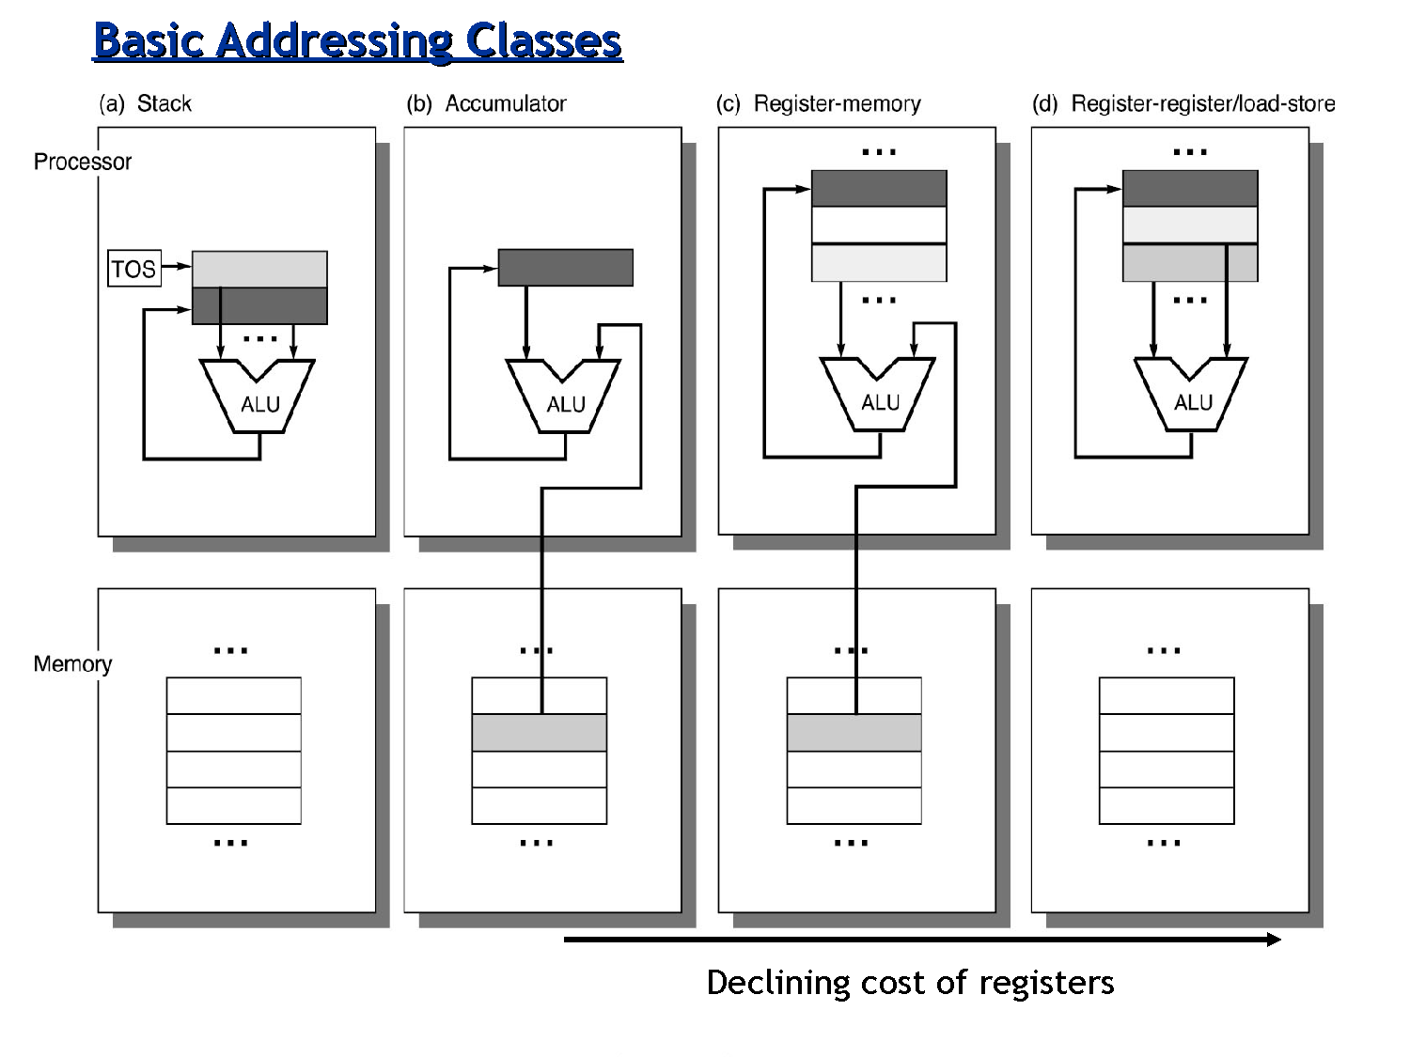

Slide 13
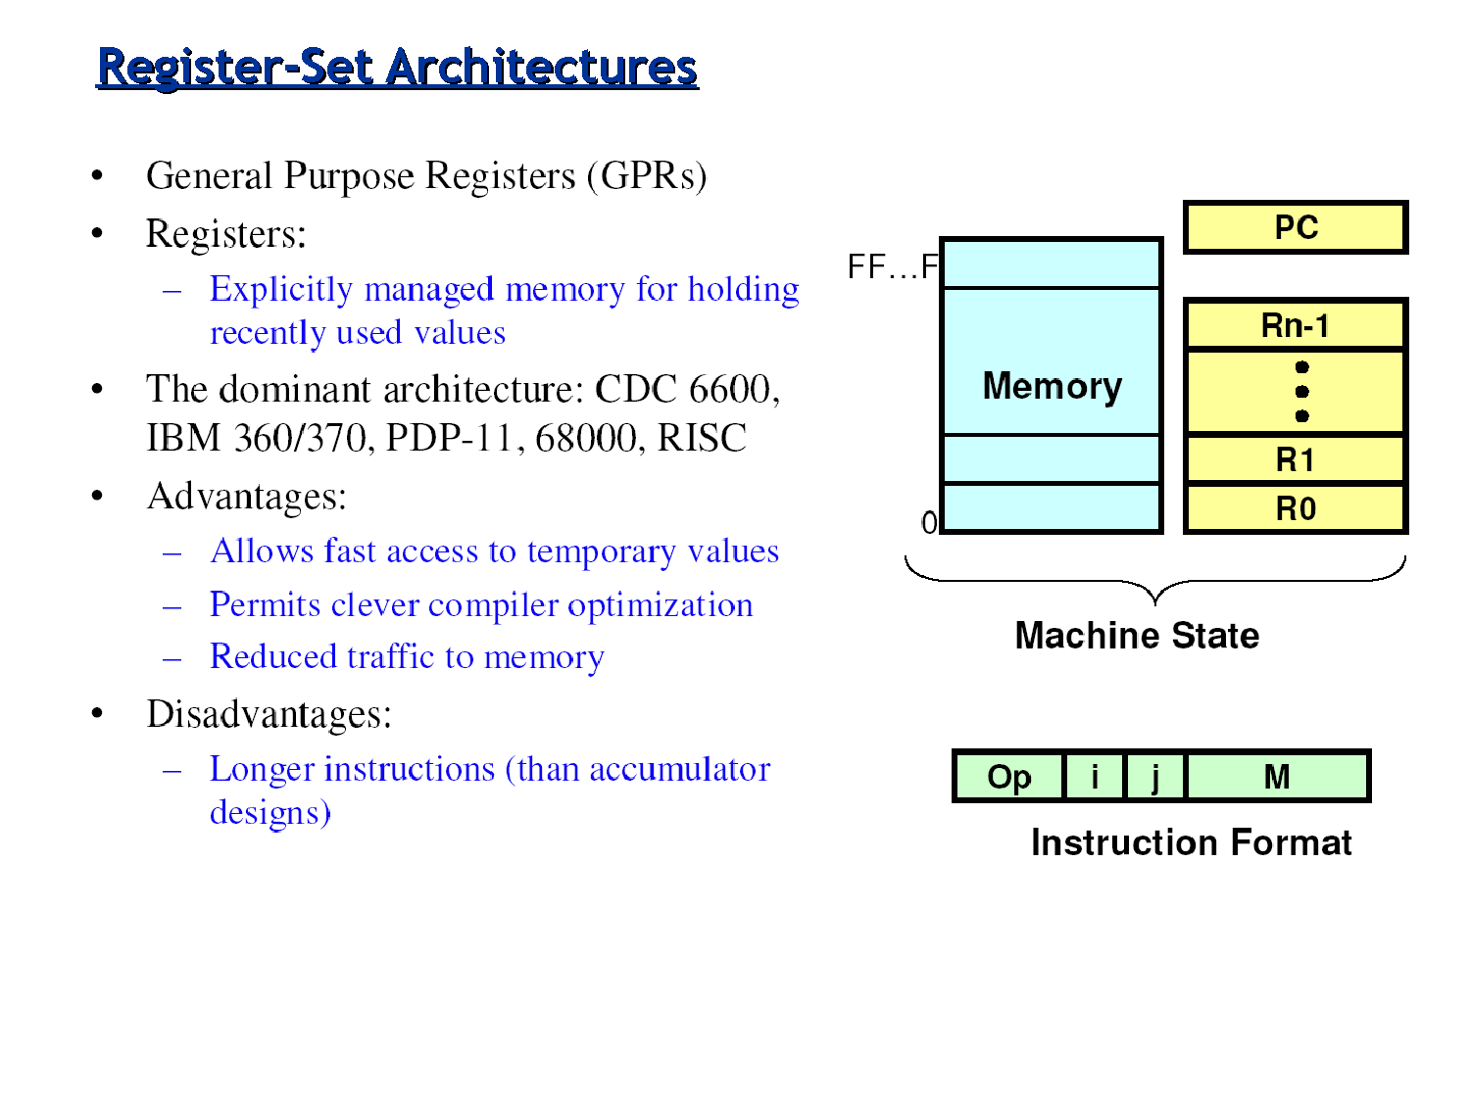

Slide 14
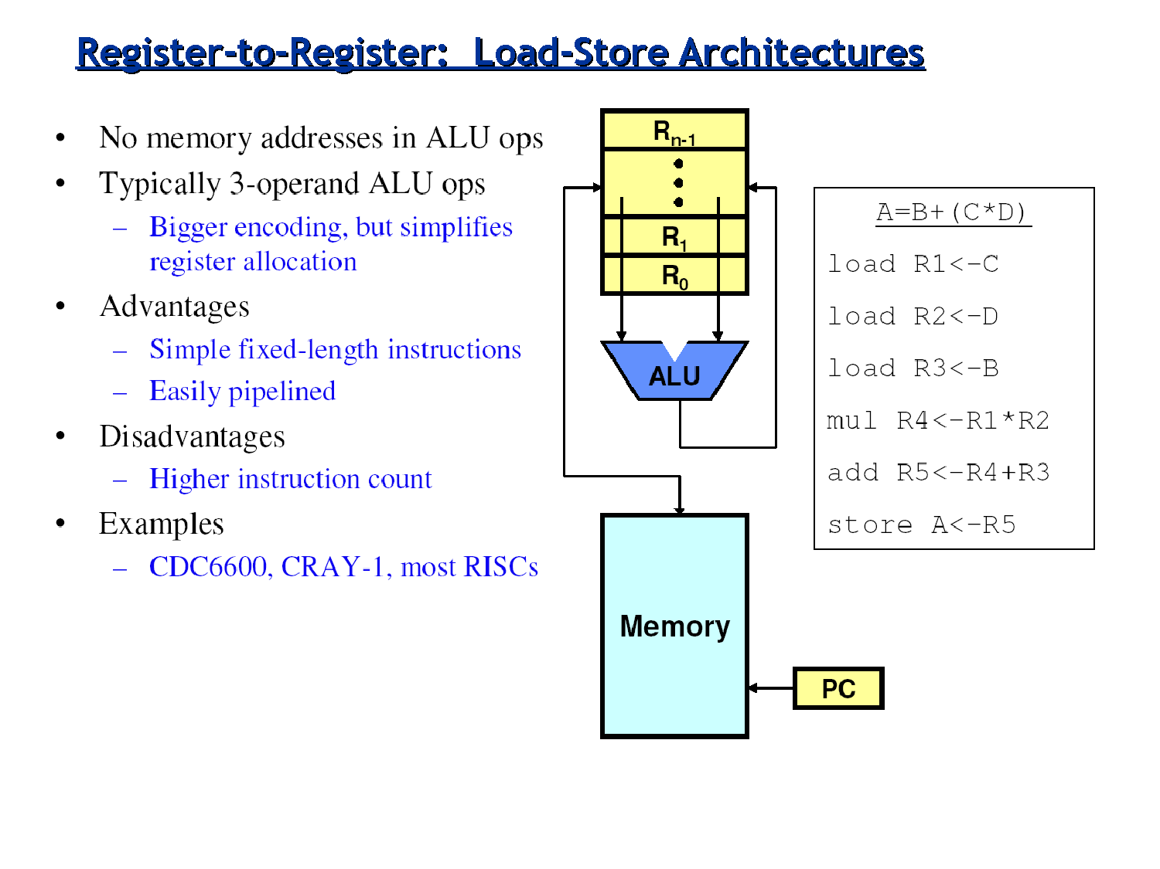

Slide 15
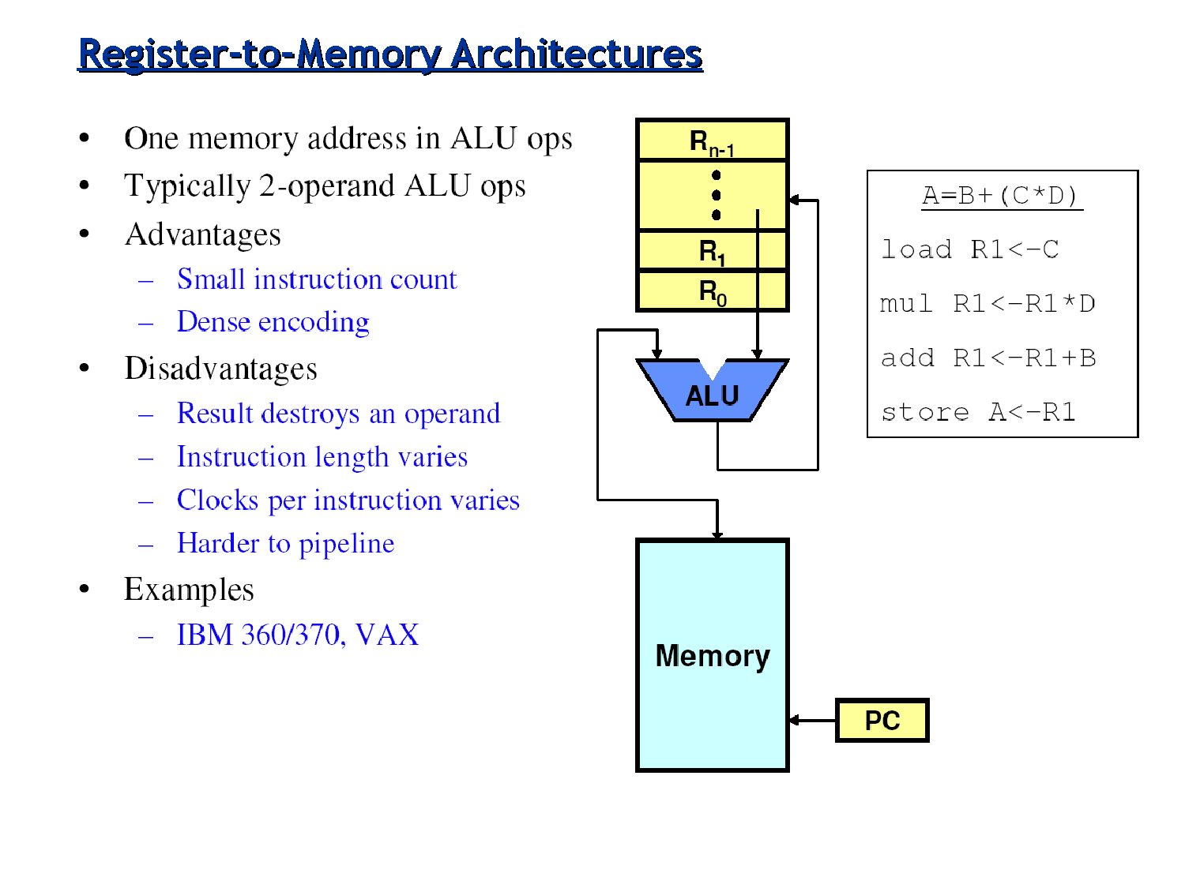

Slide 16
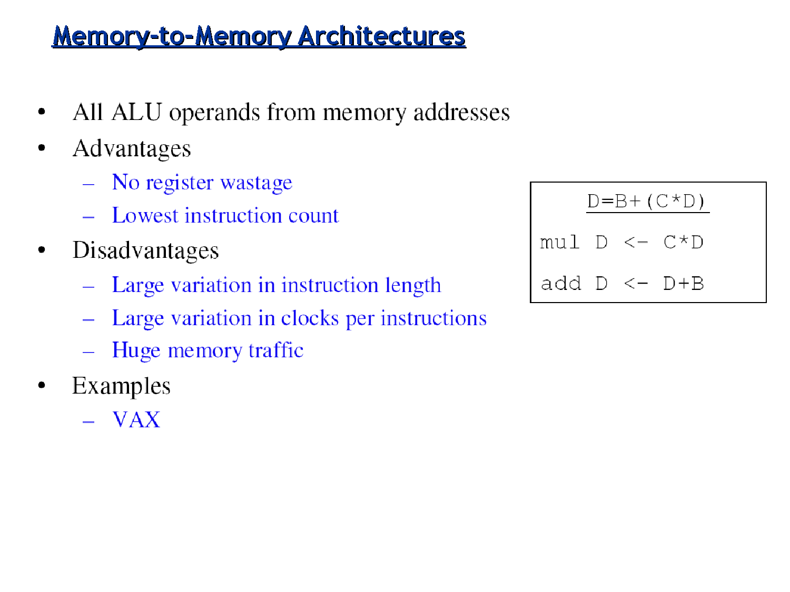

Slide 17
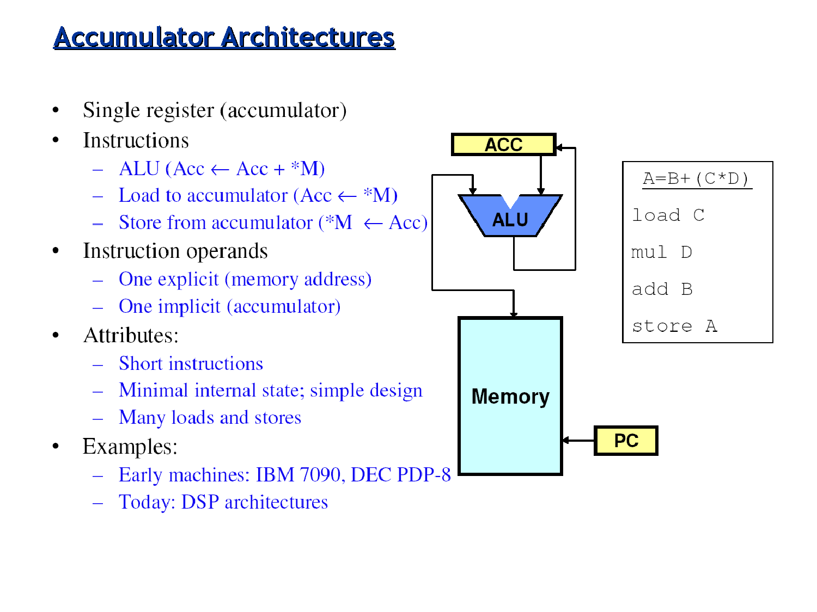

Slide 18
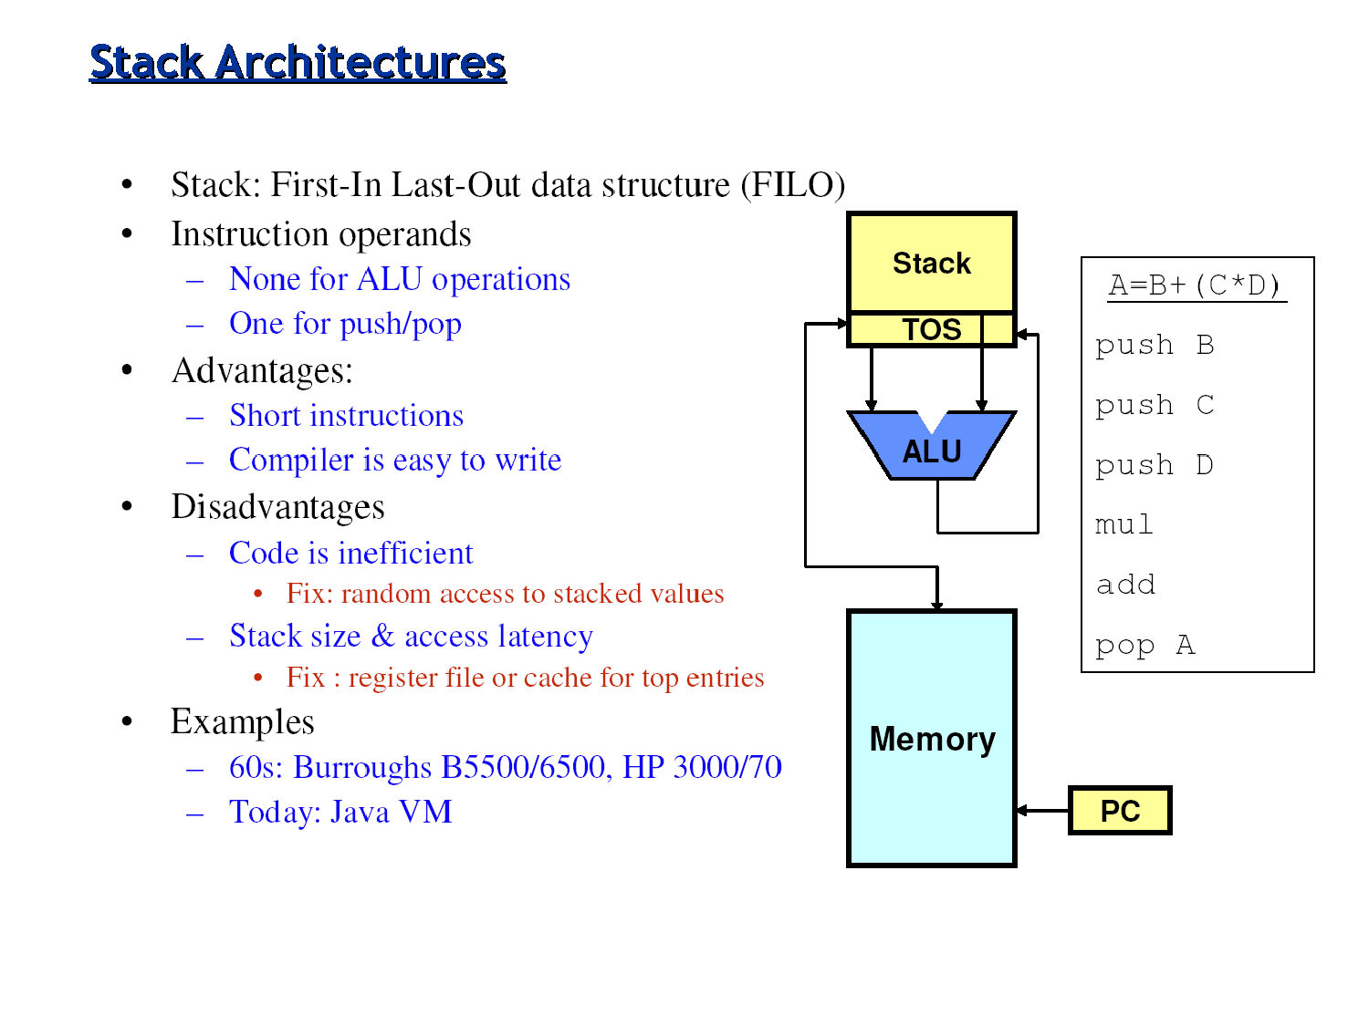

Slide 19
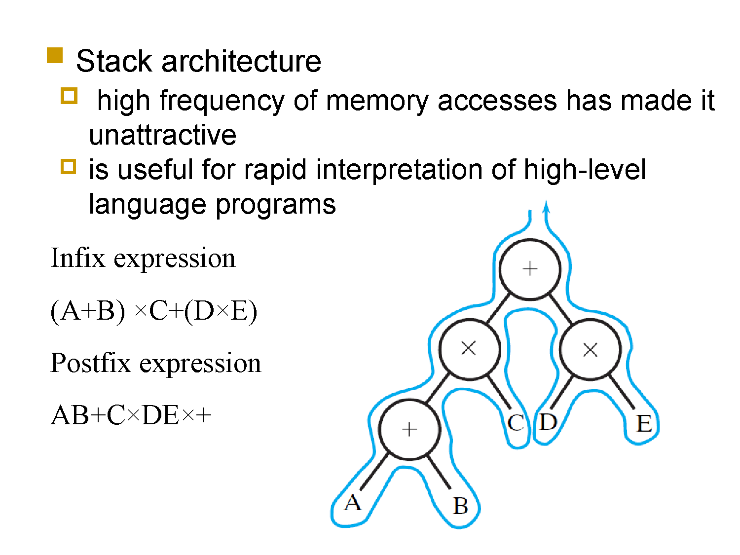

Slide 20
Number of Addresses (a)
3 addresses
  Operand 1, Operand 2, Result
  a = b + c;
  May be a forth - next instruction (usually implicit)
  Not common
  Needs very long words to hold everything
Notes:
7

Slide 21
Number of Addresses (b)
2 addresses
  One address doubles as operand and result
  a = a + b
  Reduces length of instruction
  Requires some extra work
    Temporary storage to hold some results
Notes:
8

Slide 22
Number of Addresses (c)
1 address
  Implicit second address
  Usually a register (accumulator)
  Common on early machines
Notes:
9

Slide 23
Number of Addresses (d)
0 (zero) addresses
  All addresses implicit
  Uses a stack
  e.g. push a
  push b
  add
  pop c
  c = a + b
Notes:
10

Slide 24
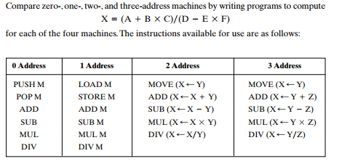
Problem

Slide 25
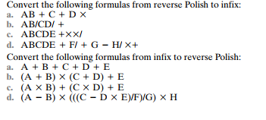
Problem

Slide 26
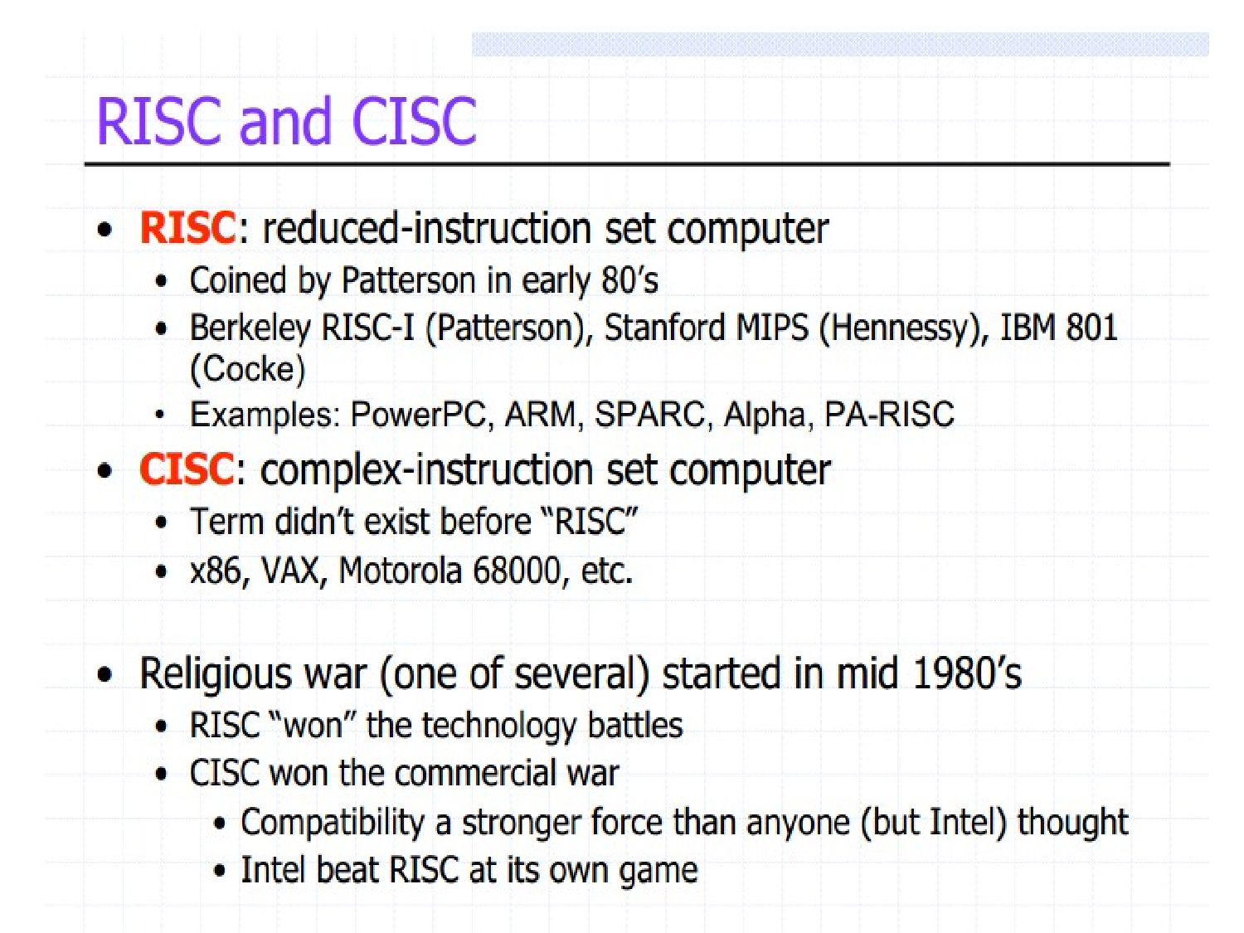

Slide 27
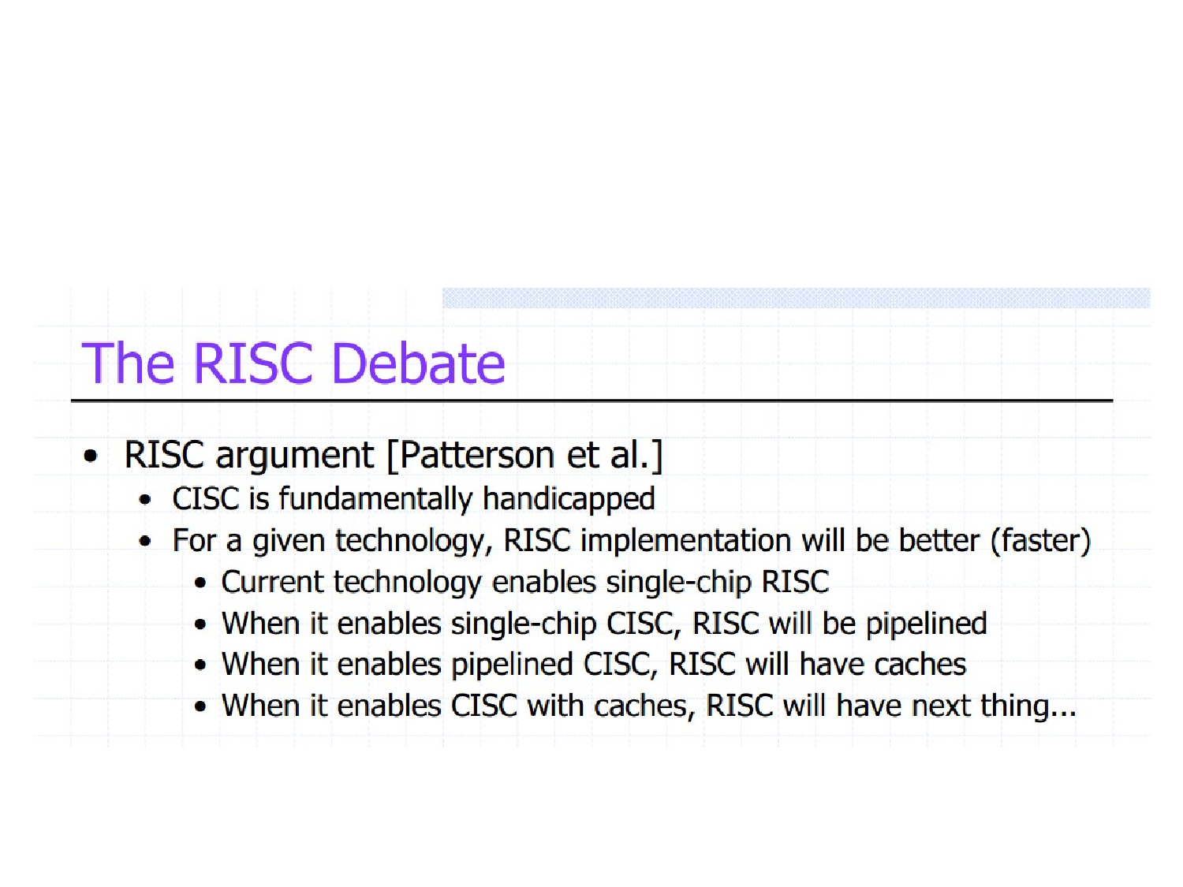

Slide 28
RISC and CISC Instruction Sets
Nature of instructions distinguishes computer
Two fundamentally different approaches
Reduced Instruction Set Computers (RISC) have one-word instructions and require arithmetic operands to be in registers
Complex Instruction Set Computers (CISC)
have multi-word instructions and
allow operands directly from memory

Slide 29
RISC versus CISC
Why CISC?
  Memory are expensive and slow back then
  Cramming more functions into one instruction
  Using microcode ROM (μROM) for “complex” operations
Justification for RISC
  Complex apps are mostly composed of simple assignments
  RAM speed catching up
  Compiler (human) getting smarter
  Memory is getting cheaper nowadays
CISC | RISC
Variable length instructions | Fixed-length instructions
Abundant instructions and addressing modes | Fewer instructions and addressing modes
Longer decoding | Easier decoding
Mem-to-mem operations | Load/store architecture
Use on-core microcode | No microinstructions, directly executed by HW logic
Less pipelineability | Better pipelineability
Closer semantic gap between high level code and assembly (shift complexity to microcode) | Needs smart compilers
Intel IA32, IBM 360, DEC VAX, Motorola 68030 | MIPS, IBM 801, IBM PowerPC, Sun Sparc

Slide 30
RISC Instruction Sets
Focus on RISC first because it is simpler
RISC instructions each occupy a single word
A load/store architecture is used, meaning:
  only Load and Store instructions are used
  to access memory operands
  operands for arithmetic/logic instructions
  must be in registers, or one of them
  may be given explicitly in instruction word

Slide 31
RISC Instruction Sets
Instructions/data are stored in the memory
Because RISC requires register operands,
data transfers are required before arithmetic
The Load instruction is used for this purpose:
Load procr_register, mem_location
Addressing mode specifies memory location;

Slide 32
RISC Instruction Sets
Consider high-level language statement:
C = A + B
A, B, and C correspond to memory locations
RTN specification with these symbolic names:
C ← [A] + [B]
Steps: fetch contents of locations A and B,
compute sum, and transfer result to location C

Slide 33
RISC Instruction Sets
Sequence of simple RISC instructions for task:
Load R2, A
Load R3, B
Add R4, R2, R3
Store R4, C
Load instruction transfers data to register
Store instruction transfers data to the memory

Slide 34
Addressing Modes
When a microprocessor accesses memory, to either read or write data, it must specify the memory address it needs to access
Several addressing modes to generate this address are known, a microprocessor instruction set architecture may contain some or all of those modes, deepening on its design
In the following examples we will use the LDAC instruction (loads data from a memory location into the AC (accumulator) microprocessor register)

Slide 35
Direct mode
Instruction
Memory
Opcode
Address A
Operand
Instruction includes the A memory address
LDAC 5 – accesses memory location 5, reads the data (10) and stores the data in the microprocessor’s accumulator
This mode is usually used to load variables and operands into the CPU

Slide 36
Indirect mode
Instruction
Memory
Opcode
Address A
Pointer to operand
Starts like the direct mode, but it makes an extra memory access. The address specified in the instruction is not the address of the operand, it is the address of a memory location that contains the address of the operand.
LDAC @5 or LDAC (5), first retrieves the content of memory location 5, say 10, and then CPU goes to location 10, reads the content (20) of that location and loads the data into the CPU (used for relocatable code and data by operating systems)
operand

Slide 37
Register direct mode
Instruction
Registers
Opcode
Register Address R
Operand
It specifies a register instead a memory address
LDAC R – if register R contains an value 5, then the value 5 is copied into the CPU’s accumulator
No memory access
Very fast execution
Very limited address space

Slide 38
Register indirect mode
Instruction
Registers
Memory
Opcode
Register Address R
Pointer to
operand
Operand
LDAC @R or LDAC (R) – the register contains the address of the operand in the memory
Register R (selected by the operand), contains value 5 which represents the address of the operand in the memory (10)
One fewer memory access than indirect addressing

Slide 39
Immediate mode
The operand is not specifying an address, it is the actual data to be used
LDAC #5 loads actually value 5 into the CPU’s accumulator
No memory reference to fetch data
Fast, no memory access to bring the operand

Slide 40
Implicit addressing mode
Doesn’t explicitly specify an operand
The instruction implicitly specifies the operand because always applies to a specific register
This is not used for load instructions
As an example, consider an instruction CLAC, that is clearing the content of the accumulator in a processor and it is always referring to the accumulator

Slide 41
Displacement addressing mode
Instruction
Memory
Opcode
Register R
Address A
Pointer to
Operand
+
Operand
Registers
Effective Address = A + (content of R)
Address field hold two values
  A = base value
  R = register that holds displacement
  or vice versa

Slide 42
Relative addressing mode
It is a particular case of the displacement addressing, where the register is the program counter; the supplied operand is an offset; Effective Address = A + (PC)
The offset is added to the content of the CPU’s program counter register to generate the required address
The program counter contains the address of next instruction to be executed, so the same relative instruction will produce different addresses at different locations in the program
Consider that the relative instruction LDAC $5 is located at memory address 10 and it takes two memory locations; the next instruction is at location 12, so the operand is actually located at (12 +5) 17; the instruction loads the operand at address 17 and stores it in the CPU’s accumulator
This mode is useful for short jumps and relocatable code

Slide 43
Indexed addressing mode
Works like relative addressing mode; instead adding the A to the content of program counter (PC), the A is added to the content of an index register
If the index register contains value 10, then the instruction LDAC 5(X) reads data from memory at location (5+10) 15 and stores it in the accumulator
Good for accessing arrays
  Effective Address = A + R
  R++

Slide 44
Based addressing mode
Works the same with indexed addressing mode, except that the index register is replaced by a base address register

Slide 45
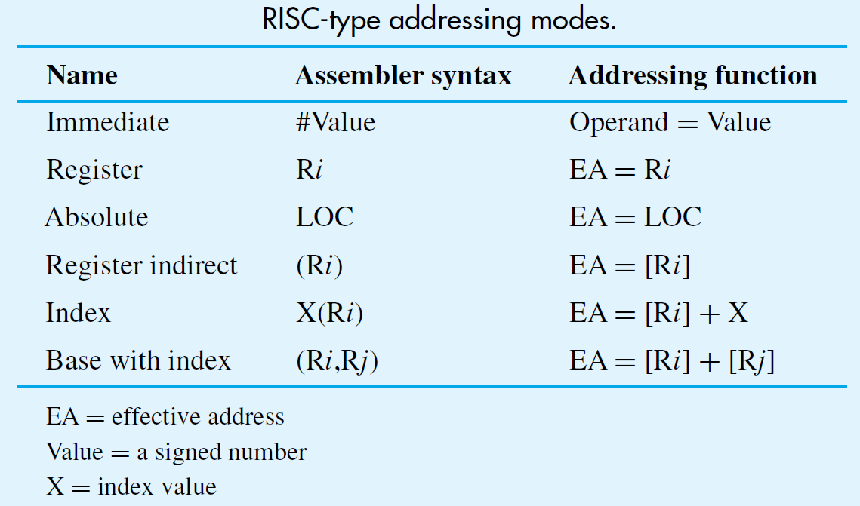

Slide 46
Assembly Language
Mnemonics (LD/ADD instead of Load/Add) used when programming specific computers
The mnemonics represent the OP codes
Assembly language is the set of mnemonics and rules for using them to write programs
The rules constitute the language syntax
Example: suffix ‘I’ to specify immediate mode
ADDI R2, R3, 5 (instead of #5)

Slide 47
Assembler Directives
Other information also needed to translate source program to object program
How should symbolic names be interpreted?
Where should instructions/data be placed?
Assembler directives provide this information
ORIGIN defines instruction/data start position
RESERVE and DATAWORD define data storage
EQU associates a name with a constant value

Slide 48
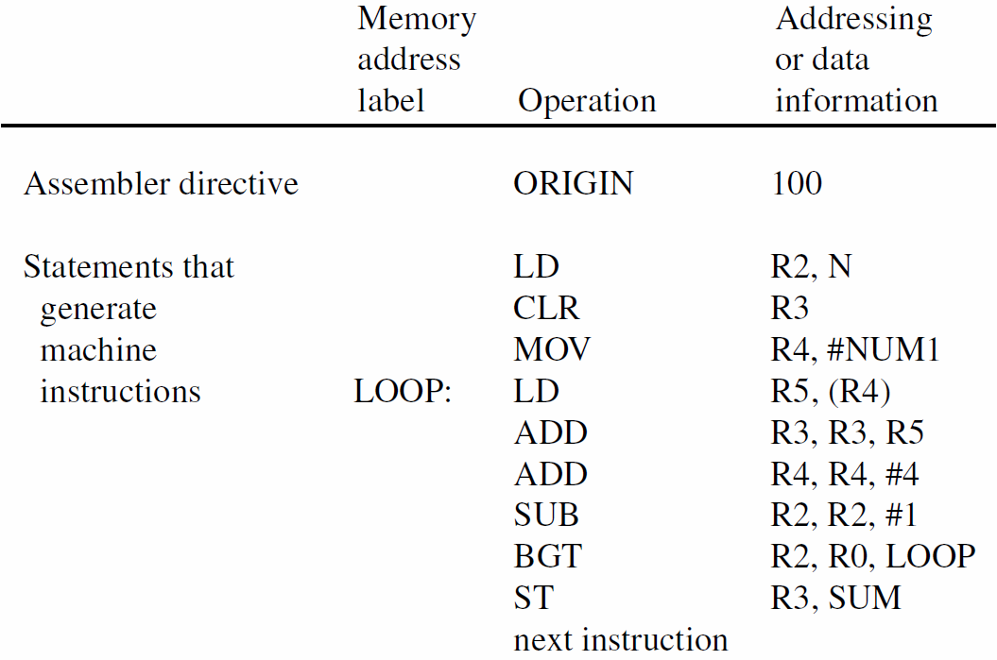
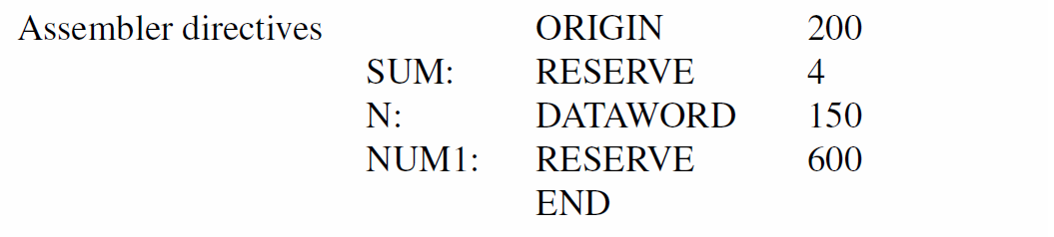

Slide 49
CISC Instruction Sets
Not constrained to load/store architecture
Instructions may be larger than one word
Typically use two-operand instruction format, with at least one operand in a register
Implementation of C = A + B using CISC:
Move Ri, A
Add Ri, B
Move C, Ri

Slide 50
CISC Instruction Sets
Move instruction equivalent to Load/Store
But also can transfer immediate values
and possibly between two memory locations
Arithmetic instructions may employ
addressing modes for operands in memory:
Subtract LOC, Ri
Add Rj, 16(Rk)

Slide 51
Additional Addressing Modes
CISC style has other modes not usual for RISC
Autoincrement mode: effective address given by register contents; after accessing operand, register contents incremented to point to next
Useful for adjusting pointers in loop body:
Add SUM, (Ri)+
MoveByte (Rj)+, Rk

Slide 52
Additional Addressing Modes
Autodecrement mode: before accessing operand, register contents are decremented, then new contents provide effective address
Notation in assembly language:
Add Rj, −(Ri)

Slide 53
RISC and CISC Styles
RISC characteristics include:
simple addressing modes
all instructions fitting in a single word
fewer total instructions
arithmetic/logic operations on registers
load/store architecture for data transfers
more instructions executed per program
Simpler instructions make it easier to
design faster hardware (e.g., use of pipelining)

Slide 54
RISC and CISC Styles
CISC characteristics include:
more complex addressing modes
instructions spanning more than one word
more instructions for complex tasks
arithmetic/logic operations on memory
memory-to-memory data transfers
fewer instructions executed per program
Complexity makes it somewhat more difficult to design fast hardware, but still possible

Slide 55
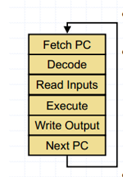
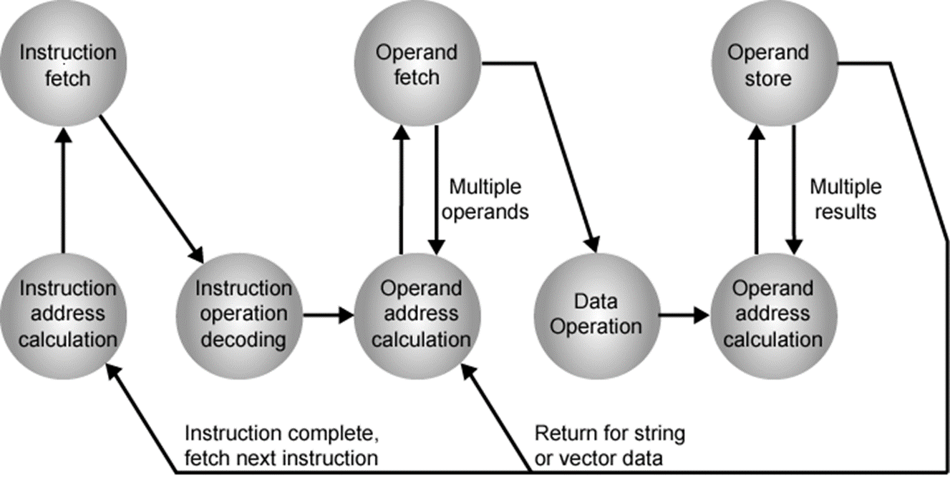
Sequential execution

Slide 56
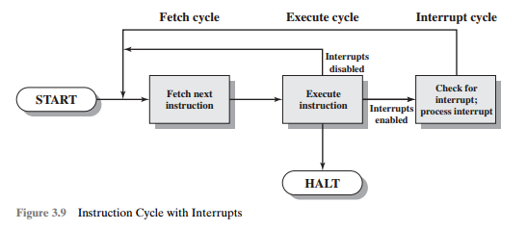
Execution with interrupt

Slide 57
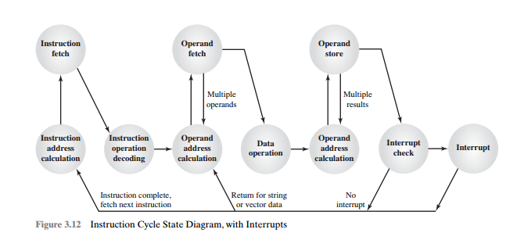

Slide 58
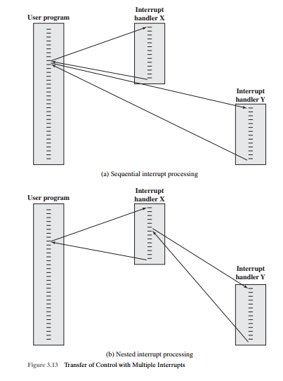

Slide 59
Instruction Types
Data Movement
Load (from memory)
Store (to memory)
memory-to-memory move
register-to-register move
input (from I/O device)
output (to I/O device)
push, pop (to/from stack)
Arithmetic
integer (binary + decimal) or FP
Add, Subtract, Multiply, Divide
Shift
shift left/right, rotate left/right
Logical
not, and, or, set, clear
Control (Jump/Branch)
unconditional, conditional
Subroutine Linkage
call, return
Interrupt
trap, return

Slide 60
Operand Types
Addresses
Numbers
  Integer/floating point
Characters
  ASCII etc.
Logical Data
  Bits or flags
Notes:
14

Slide 61


Instruction Length
Fixed Length
  RISC computers have fixed length instructions
Variable Length
  12-bits
  36-bits
More operands
  less instructions
  larger words
Less operands ->
  shorter decode time
  Longer programs

Slide 62
Instruction length
Fixed Length
  Pro: Decodes faster (Not exactly)
    Less Complexity
  Con: Wastes Space
    Opcodes that do not require operands such as MARIE’s halt makes no use of its address space.
    Additionally, instructions must be word aligned. Creates gaps in memory

Slide 63
Instruction Length
Variable Length
  Pro: Saves storage space (Not exactly)
    Instructions take up only as much space as needed
    Instructions must be word aligned in main memory
    Therefore instructions of varying lengths will create gaps in main memory
  Con: Complex to decode

Slide 64
Control Instructions
Used to alter the sequence of instructions
(by changing the Program Counter)
Conditional Branch
  branch is taken if a specified condition is true
    signed offset is added to PC to yield new PC
  else, the branch is not taken
    PC is not changed, points to the next sequential instruction
Unconditional Branch (or Jump)
  always changes the PC
TRAP
  changes PC to the address of an OS “service routine”
  routine will return control to the next instruction (after TRAP)

Slide 65
Condition Codes
There are three condition code registers:
N -- negative
Z -- zero
P -- positive (greater than zero)
Exactly one will be set at all times
  Based on the last instruction that altered a register

Slide 66
Branch Instruction
Branch specifies one or more condition codes.
If the set bit is specified, the branch is taken.
  PC-relative addressing:
  target address is made by adding signed offset (IR[8:0])
  to current PC.
  Note: PC has already been incremented by FETCH stage.
  Note: Target must be within 256 words of BR instruction.
If the branch is not taken,
the next sequential instruction is executed.

Slide 67
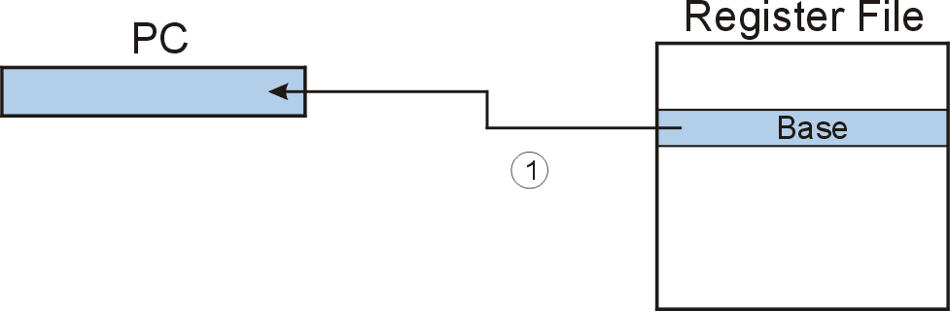
JMP (Register)
Jump is an unconditional branch -- always taken.
  Target address is the contents of a register.
  Allows any target address.

Slide 68
OLD questions
Why state diagram is required? Explain the state diagram of instruction cycle with interrupts?
Differentiate between RISC and CISC architecture with suitable examples.
Explain different types of operations used in a computer. Why data transfer operation has maximum number of opcodes? Differentiate between 3, 2, 1, and 0 addresses.
Explain the state diagram of instruction cycle (with interrupts). How can you handle multiple interrupts?
What do you mean by addressing in a computer? List different types of addressing modes. Explain in detail about displacement, relative, and indexed addressing modes with required block diagrams.

Slide 69
Practice Questions
Q 1: What are the typical elements of a machine instruction?
Q 2: What are the different categories of instructions?
Q 3: Why are transfer of control instructions needed ?
Q 4: If an instruction contains four addresses, what might be the purpose of each address ?
Q 5: List and explain the important design issues for instruction set design.
Q 6: What are the different types of operands may present in an instruction.
Q 7: Briefly explain the following addressing modes- immediate addressing direct addressing, indirect addressing displacement addressing and relative addressing
Q 8: What is indexed addressing and what is the advantage of auto indexing ?
Q 9: What are the advantages and disadvantages of using a variable-length instruction format ?

Slide 70
Q 10: An address field of an instruction contains decimal value 250. Where is the corresponding operand located for-
a. Immediate addressing
b. Direct addressing
c. Indirect addressing
d. Register addressing
e. Register indirect addressing

